Slide 1

Big Bang at School:
2021/22 evaluation findings
November 2022

Slide 2

Table of contents
Introduction
Who responded to the surveys?
Who participated in Big Bang at School?
Student and teacher experiences of Big Bang at School
Informing, inspiring and empowering students and those who support them
Learning for improvement
Conclusions and recommendations
1. Footnotes where required

Slide 3
Introduction
The Big Bang at School programme enables schools that meet EngineeringUK’s EDI criteria¹ to host a STEM event in their own school environment, which demonstrates the breadth of STEM careers and get students involved in hands on STEM activities and workshops. The model is unique in its outreach in that it is for the whole school. It is delivered by directly targeting schools across the UK, providing bursaries and assistance through delivery partners with the aim to enhance teacher support and confidence.
In 2021/22:
38 EDI schools delivered a Big Bang at School
around 11,000 students attended
a Big Bang at School
This report presents feedback from students and teachers who took part in the Big Bang at programme in 2021/22, gathered via a mix of online surveys and virtual teacher interviews. Throughout the year, two evaluation approaches were trialled, both incentivising schools to make time within the school day for their students to complete the surveys. One consisted of collecting data before and after the event (pre- and post- approach) and the other an post-only approach.
Feedback from students enables us to better understand their experiences and any perceived impact they feel the programme has had on their skills, their interest in engineering careers or in taking part in more STEM related activities. It also helps us to explore more generally their attitudes towards STEM and whether there are differences in overall programme experience based on students gender, ethnicity, year group or eligibility for free school meals (FSM).
Feedback from teachers provides insights into their perspective on the programme’s impact for students, any additional benefits for the school, and what they feel they have gained from participating.
This information allows us to continually improve the programme and the processes of delivering it, and to gain some understanding of how far the programme is meeting its aims of informing and inspiring young people into further STEM study and careers.
We also ask for teachers’ recommendations and suggestions for further inspiring young people in STEM. These views help to shape future iterations of this programme and the wider work of EngineeringUK.
1. Equality, Diversity and Inclusion criteria, based on student population with higher numbers from groups typically under-represented in engineering. For more detail, see EngineeringUK EDI Criteria - Tomorrow's Engineers (tomorrowsengineers.org.uk)

Slide 4
Who responded to the student survey?
Students were invited to take part in our survey through teachers sharing online links after the programme, between March and July 2022.
The table below provides a breakdown of the demographics of students who completed a post-event survey in the past year. In total, we had 1,198 responses from students at 15 different schools.²
 |  |  | Students responding to survey | Completed survey N (%)
 |  |  | Number | %
Total |  |  | 1,198
Year Group³ (n=768) | Year 7 Year 8 Year 9 Year 10 Year 11 |  | 329 236 180 15 8 | 43% 31% 23% 2% 1%
Gender (n=988) | Female Male Non-binary or other self-description Prefer not to say |  | 687 203 55 43 | 70% 21% 6% 4%
Ethnic groups (n=987) | Asian/Asian British Black/Black British Mixed or multiple ethnic groups White Other ethnic identity Prefer not to say |  | 207 64 71 538 32 74 | 21% 6% 7% 55% 3% 7%
Receive Free School Meals (n=756) |  | Yes No I don’t know Prefer not to say | 601 84 46 25 | 79% 11% 6% 3%
2. Fourteen students did not specify the school name in their survey response.
3. Year groups referenced are based on England and Wales. Northern Ireland responses were recategorized to equivalent English year group for a total figure across nations. No responses from Scotland were collected.

Slide 5
How do respondents engage with STEM?
We asked students a series of questions to explore their pre-existing engagement in STEM. Two thirds of students responding said they participate in at least one science related activity outside of school, with one third (32%) reporting high STEM engagement (3+ activities).
On average, students said they were already engaged in 1.8 of the 8 activities asked about.
We categorised students into three groups based on the number of STEM activities they said they do. Those who said they do no STEM activities listed were classed as ‘low’, those who do 1 or 2 are classed as ‘medium’ and those who do 3 or more are classed as ‘high’ STEM engagement.⁴
Among those who responded to the survey, we found no difference in the mean number of activities engaged in by female students (1.75) compared to male students (1.78).⁵ There is no difference between students receiving Free School Meals (1.61) and those not receiving FSM (1.83).⁶ We also did not find any differences between students of different year groups (Year 7=1.80; Year 8=1.90; Year 9=1.71).
In comparison with other EUK programmes, Big Bang at School participants are less likely to have high STEM engagement than students participating in the Big Bang Fair (High – 47%, Medium – 36%, Low – 17%), Robotics Challenge (High - 67%, Medium – 25%, Low – 7%) or Big Bang Competition (High – 63%, Medium 33%, Low – 4%).
This could be a reflection of the way in which students can access a Big Bang at School event hosted for their whole school or year group, compared to programmes or competitions where there is a tendency for students to be self-or teacher selected.
Knowing someone working in STEM is a good predictor for having an interest in a STEM career. Compared to our other programmes, fewer students participating in Big Bang at School also reported knowing a STEM professional. While 44% of students reported not knowing anyone who works in a STEM related career, a majority of the respondents said they knew a parent or guardian (15%), another family member (27%), a family friend (18%) or someone else (15%).
Environmental concern and STEM
We asked students three questions to assess their personal commitment to environmental concerns: ‘I try to be environmentally friendly in the things I do’, ‘I am interested in issues around climate change and other environmental issues’, ‘I do things to try to influence others to be environmentally friendly’. On average, students agreed with 2 out of these 3, and 34% agreed with all 3, showing a high level of personal commitment to environmental issues.
4. The full list of activities respondents could choose from included: Watch science programmes on TV or online (e.g. YouTube); Visit science museums or displays; Read about science on the internet; Read science books (including science fiction); Create my own computer games, website or animation; Go to a science or engineering fair; Attend a science, technology, engineering or maths club; Listen to a podcast or radio programme about science; None of the above.
5. Comparison of means, t(677)=-0.15, p=0.88
6. Comparison of means, t(683)=1.07, p=0.29

Slide 6
Who responded to the teacher survey?
Lead teachers for each school were invited to take part in our feedback survey and share the invite link with any teacher involved in running Big Bang at School in their school. Data was collected between March and July 2022 and we received a total of 54 responses from teachers at 20 different schools. This represents 53% of all schools who engaged in Big Bang at School. All schools involved in the programme in 2021/22 met EUK’s EDI criteria.
Most of the teachers responding were science teachers, with a majority indicating they teach more than one STEM subject. A small number reported they do not teach a STEM subject at all.
Fewer respondents tended to teach subjects related to technology, engineering or maths. The low number of those teaching engineering subjects is more likely to reflect the small numbers of school who offer this subject at GCSE level.
Nearly half (48%) of teachers who responded said they had some responsibility for careers advice in their school.
Note: percentages do not add to 100% as participants had the ability to select more than one response option.

Slide 7
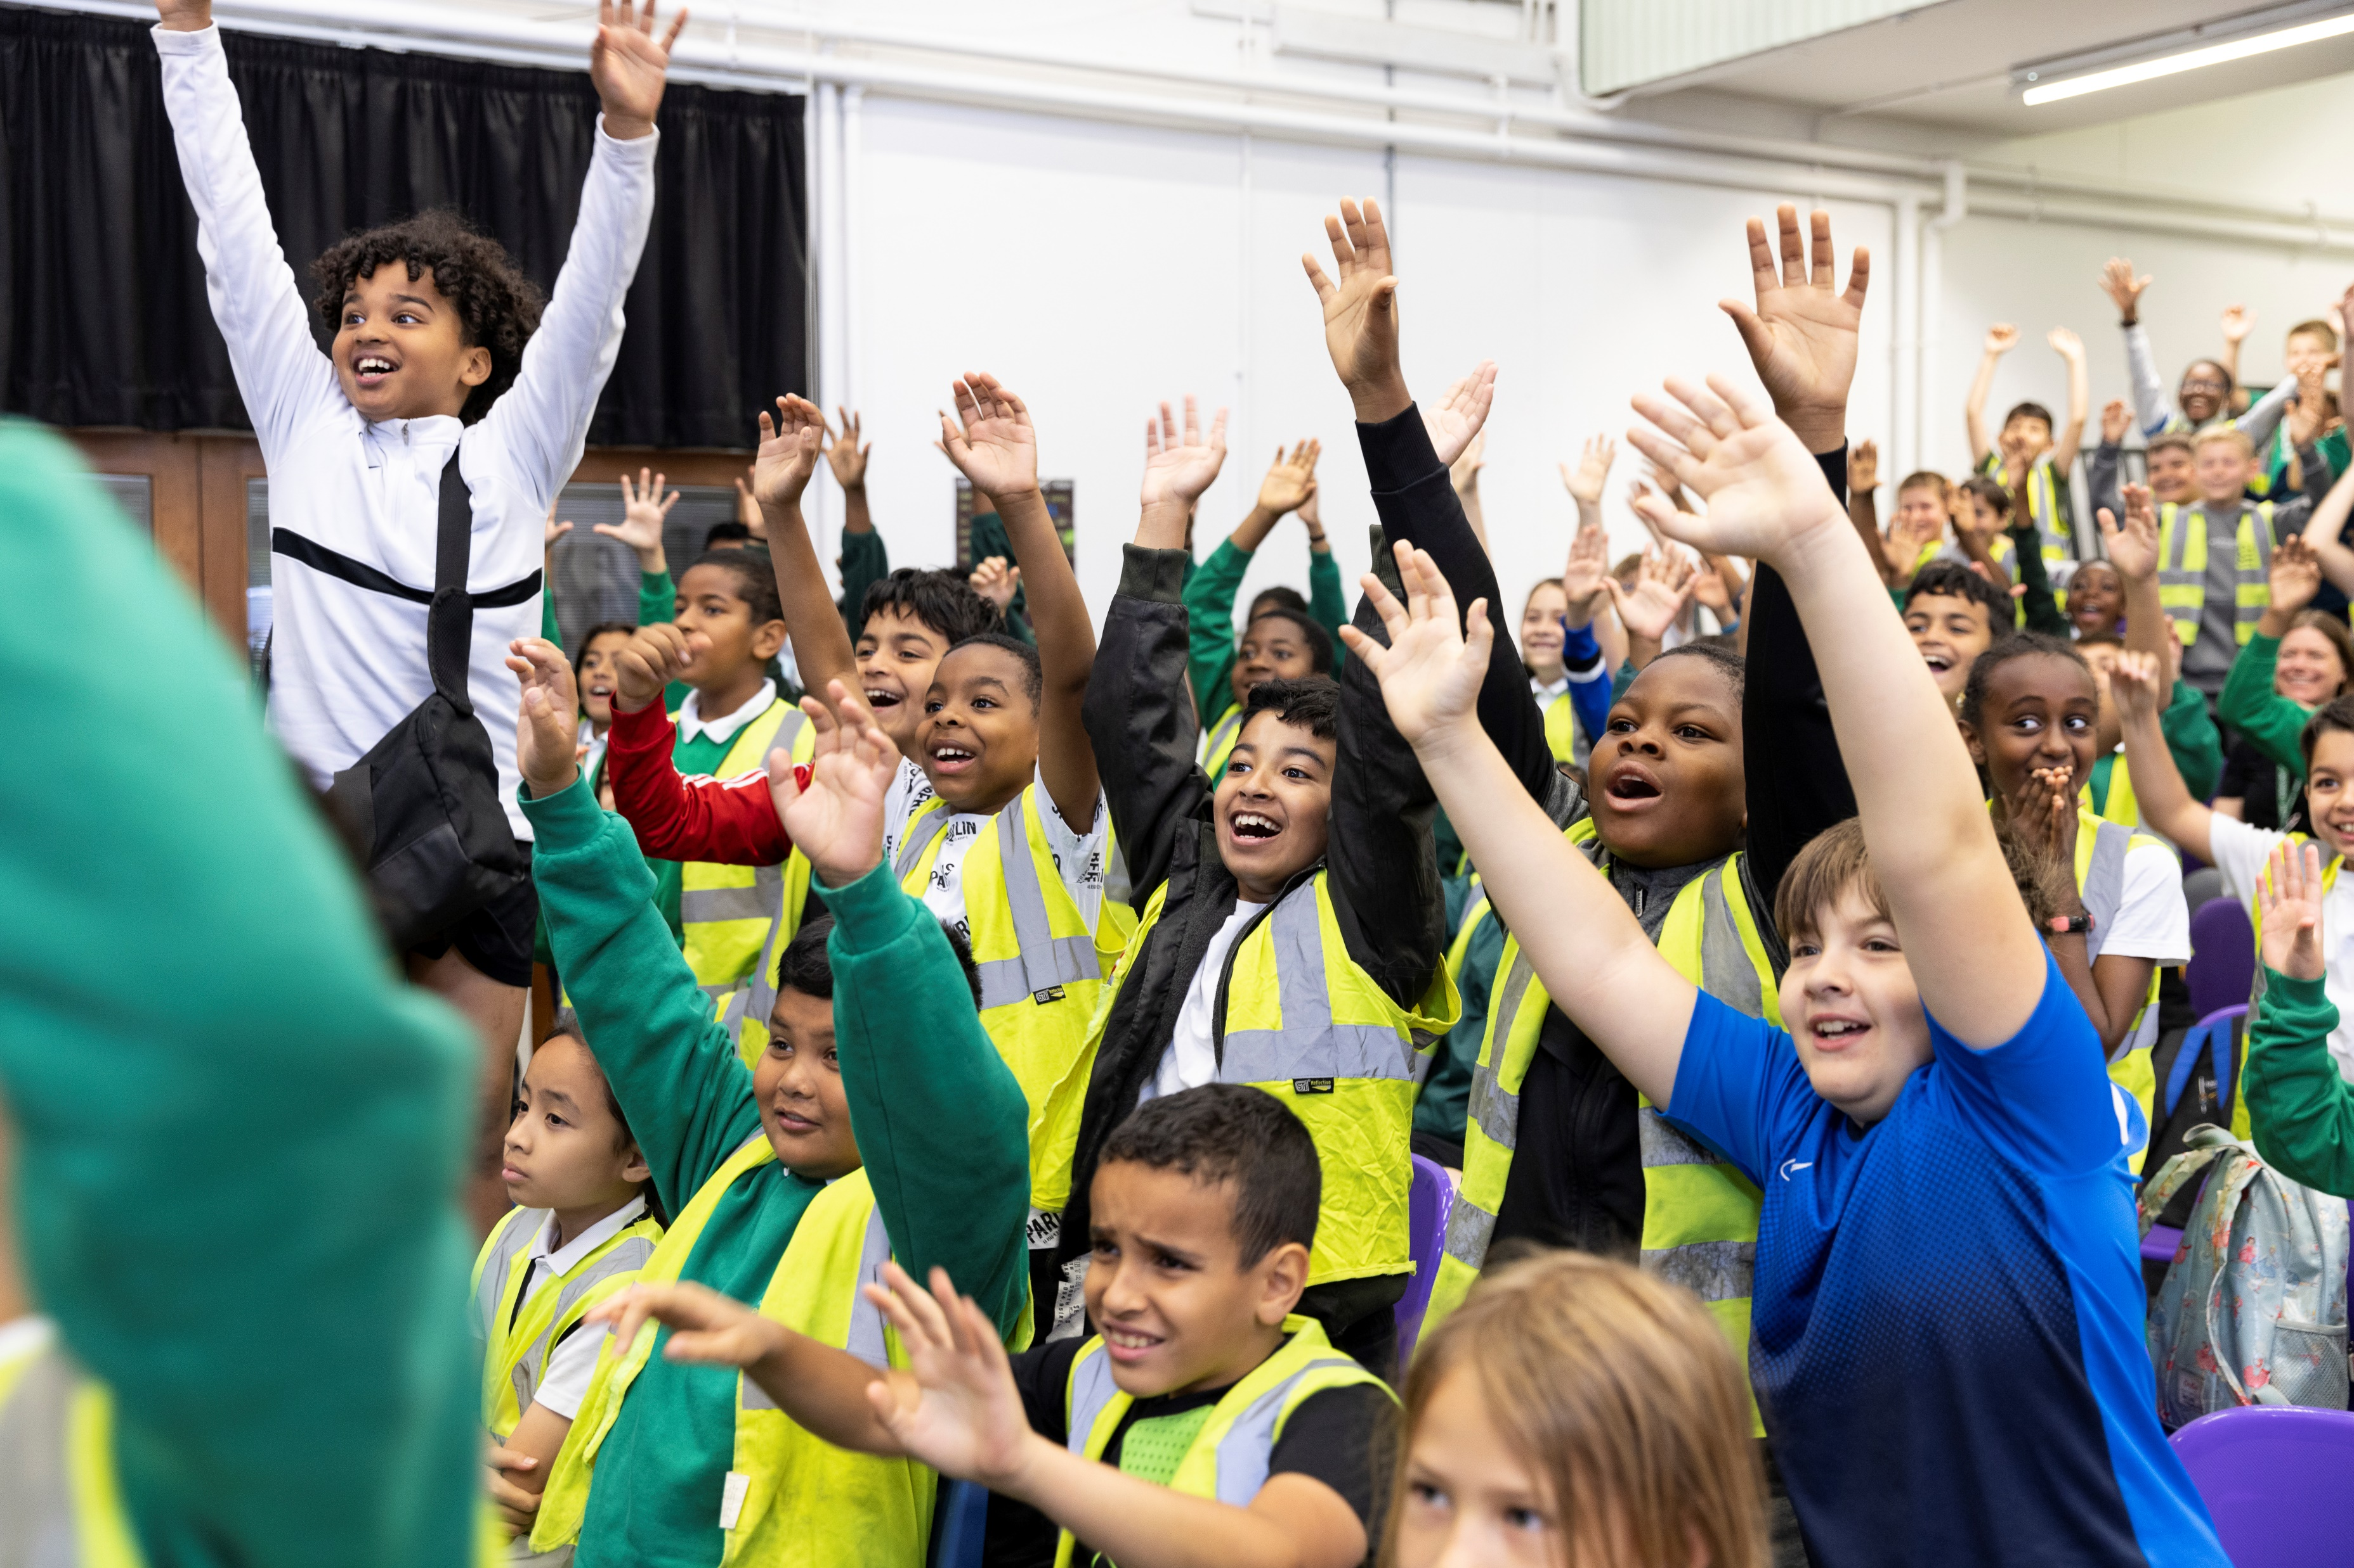
Who participated in
Big Bang at School?

Slide 8
How is Big Bang at School delivered?
Big Bang at School is unique in the STEM outreach space in that it is a STEM event intended for the whole school. Participating schools receive financial support (via a bursary scheme) and help from delivery partners to organise a STEM event tailored to their context. Following feedback collected in 2020/21, EngineeringUK reviewed the content to ensure consistent engineering careers messaging was included throughout the programme.
Delivery partners
In 2021/22, EngineeringUK’s delivery partners, five organisations based across the UK, recruited schools to take part in the programme and provided tailored support for teachers in choosing the activities to deliver that work for their needs and context. They also provided teachers with links to local ambassadors and support on the day of the event, if needed.
Programme content
Big Bang at School is made up of a variety of STEM activities, divided into three collections, based on the time and theme of each.
The first collection includes shorter hands-on activities, such as making slime or bath bombs, or workshops made up of a series of activities on topics such as designing sustainable textiles or the next Mars rover. These type of activities can last anywhere from 15 minutes to 6 hours.
The second collection is made up of longer challenges which include a component of individual or team project work, which students can then use to enter in the Big Bang Competition. These activities can last anywhere from 8 hours or more.
The third collection is a careers focused activity, such as a mini careers fair, Q&A panel or use of the Meet the Future You Quiz. Teachers are encouraged to choose one activity from each collection. While not a requirement, this delivery model is a guide to encourage schools to deliver at least a half day to one day event. Teachers can decide to use free activities available through the programme, pay for additional ones on Neon, or include their own activities and those of local STEM employers.
Bursaries
In 2021/22, the Big Bang at School programme was primarily run for schools that meet EngineeringUK’s EDI criteria. All schools that took part in the programme were offered financial support. Those involved for the first time were given a bursary of £1000 and repeat schools, who had received a bursary the previous year, were offered £500. The aim of the bursary was to support schools in making the Big Bang at School experience more engaging for students, particularly those from groups under-represented in engineering. Teachers spent the additional funds mostly on resources to support delivery, as well as for activities for their students. For more information on the bursary evaluation findings, please refer to the bursary report.

Slide 9
Who participated in the programme?
Teachers organise Big Bang at School programme activities in their schools in a variety of ways: a majority involve all students in one or more year groups; some reported their whole school takes part; others also invite local primary and secondary schools to their event.
55% of teachers planned to involve all students in one or more year group and 23% the whole school
Schools involve around 260 students in
Big Bang at School activities, on average
Teachers completing the bursary application form (31 of 38 EDI schools) reported their school involves a number of students ranging from 75 to over 1,600. Given how teachers reported they planned to include students in Big Bang at School activities, it’s likely the numbers also vary based on the size of the school.
The majority of teachers said they planned to include all students in one or more year groups (55%) or the whole school (23%). Out of the remaining teachers, some reported they did not know yet (10%), others wanted to include any interested student (3%), and in some cases teachers were planning on selecting students (3% selecting students from one class, not based on ability or particular stream; 3% selecting students who are not currently engaged / inspired by STEM subjects; 3% selecting students who they think would not typically have an opportunity to take part in this kind of activity).
Based on the feedback survey teachers took part in after the event, one third of respondents (33%) reported their students had the chance to meet an engineer during their Big Bang at School (29% said their students not meet an engineer, and 39% said they didn’t know).⁷
The table below shows the reasons the EDI schools were eligible for EngineeringUK’s EDI criteria.
Reason eligible for EDI criteria | N (%)
Above average FSM and Ethnicity | 15 (39%)
Significantly above average FSM | 9 (24%)
Top 40 FSM ⁸ | 3 (8%)
Significantly above average Ethnicity | 3 (8%)
Special School | 2 (5%)
Rural school | 2 (5%)
Single sex Girls School and above average FSM or Ethnicity | 1 (3%)
N/A (new institution or information not available) | 3 (8%)
Total | 38
7. As any teacher involved in delivering their school’s event was invited to provide feedback, it could be that those reporting ‘don’t know’ were running a particular session or supporting in another way, not knowing, whether students had the chance to meet engineers in other activities.
8.‘Top 40 FSM’ is used only for schools in Northern Ireland as data on ethnicity is not available for that country. For more detail, see EngineeringUK EDI Criteria - Tomorrow's Engineers (tomorrowsengineers.org.uk)

Slide 10
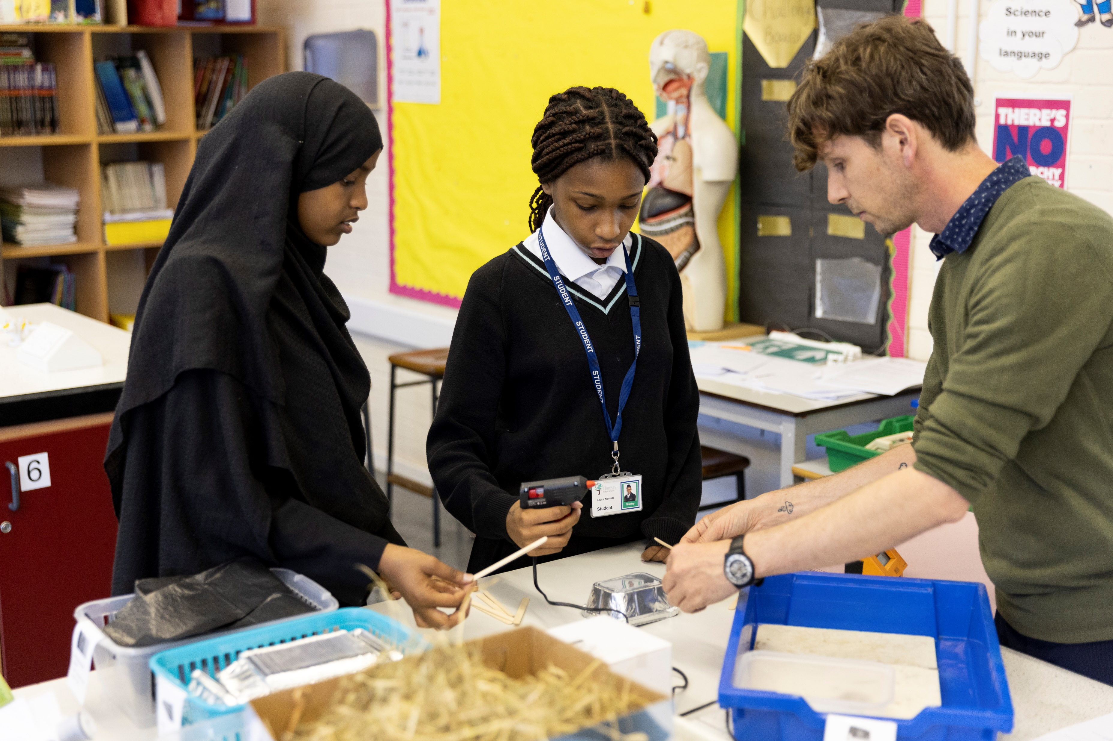
Student and teacher experience of Big Bang at School

Slide 11
Student experience of Big Bang at School
The programme’s aim to inspire young people to consider further STEM study and careers is based on providing an experience that is enjoyable and engaging to young people. We asked students about their experience of Big Bang at School and ran a logistic regression to identify any factors that predicted their enjoyment of the event.⁷
I enjoyed the experiments because they were the type of experiments that we don't do in our science class.
I enjoyed the diverse jobs that I didn't even know involved engineering.
I enjoyed being part of it and explaining my stand to everybody and all the fun activities that were available.
74% of students agreed that they enjoyed Big Bang at School
Nearly three quarters of students who took part in the survey reported they enjoyed Big Bang at School. An additional statistical analysis method was used to explore the relationship between demographic characteristics, students’ STEM engagement and whether they already know someone in STEM on the probability of students agreeing they enjoyed Big Bang at School.
Following a logistic regression, knowing someone who works in STEM and ethnicity remain significant predictors of enjoyment of the programme, when controlling for other factors.
Holding all other variables constant,⁸
students who knew someone working in a STEM career were about 70% more likely to enjoy Big Bang at School, compared to those who did not know a STEM professional (OR=1.73, 95%CI 1.18-2.56,p=0.005).
Asian students were around 80% more likely to enjoy Big Bang at School compared with white students, when other factors are controlled for (OR=1.81, 95%CI 1.13-2.92, p=0.01).
8. Variables tested for logistic regression in this report include: gender, ethnicity, year group, knowing someone working in STEM and STEM engagement.

Slide 12
Student experience of Big Bang at School
Students who enjoyed taking part in the Big Bang at School were asked what they particularly enjoyed about Big Bang at School. We received nearly 600 free text responses categorised below to show which aspects of the programme were commonly mentioned:
Hands on activities
Over half of the responses mentioned they enjoyed the activities overall (321 responses). The hands on element of activities and experiments was valued in particular (219) – specific workshops mentioned include “Explosive Food”, building robot cars and creating windmills.
Student stands
Beyond the practical activities, 110 responses referred to the stands as the aspect they enjoyed about the programme. Some specified they liked the variety both of activities as well as the variety of projects presented at the stands and learning from other students about their experiments.
Overall Fun
Some students mentioned that they enjoyed everything about Big Bang at School. Around 80 responses mentioned the day was fun and they particularly enjoyed the opportunity to learn about something new related to STEM and STEM careers.
Learning about STEM careers
Around 80 responses specifically mentioned they enjoyed learning about STEM careers. Students found it interesting to understand what professionals do in their jobs, the variety of careers and the links between the programme activities and related STEM roles. Others specifically mentioned they enjoyed interacting with STEM professionals.
“There were lots of different things to do, all about different parts of STEM. They were really fun because they were interactive, so we didn't just have to sit and watch.”
“[I enjoyed] the interactions and hands-on experiences as they helped me to have a deeper understanding of the impacts and applications of STEM careers.”
“I thought it was really fun to see everyone's different approaches to experiments and I think it was very beneficial to helping those who may want to pursue an engineering based career but don't know it yet.”
“What I enjoyed about Big Bang at School is that it was educational and fun at the same time.”
“I really enjoyed looking at the different types of jobs that are available and the beneficial impacts that they bring to our environment and our society. My favourite part was that I could find more out about STEM throughout many fun activities.”

Slide 13
Teacher experience of Big Bang at School
Teachers’ rating of the Big Bang at School is critical, both as the main decisionmakers for running the programme in future, and for their insights into how effectively it meets their, and their students’, needs.
Teachers were overwhelmingly positive about their experience of the programme:
“An amazing opportunity for students to showcase their projects and to develop their communication skills. It was fantastic for students to find out about different STEM careers and pathways that they could follow.”
94% of teachers rated
Big Bang at School as
‘good’ or ‘excellent’
“This was an excellent opportunity for employer encounters and to support students to see a wider picture of range of jobs in the STEM sector.’”

Slide 14
Teacher experience of Big Bang at School
Reflecting on their overall positive experience, three key aspects of Big Bang at School were highlighted by teachers who rated their experience of the programme as good or excellent: the engaging activities for students, the overall organisation planning and resources available and the element of learning about STEM careers.
Engaging activities
Out of the 38 teacher responses to this question, 15 mentioned the programme was overall engaging for their students. A further 7 responses highlighted the variety of activities, and 6 mentioned the interactive/ hands on element of the workshops as being engaging. Other responses (3) highlighted the student project work as being a good opportunity for students to showcase their work and develop skills.
Organisation, planning and resources
Fourteen responses valued the overall organisation of the programme and the support in planning Big Bang at School activities, with 6 specifically referring to staff as being helpful throughout the programme. In addition, 7 responses mentioned the resources available were also helpful.
STEM careers engagement
Another theme that emerged from the responses is the importance of information on STEM careers and engagement with STEM professionals. Eight responses highlighted this as a positive element of the programme.
“It was an interactive experience that engaged students. It allowed them to see science in a different light and they really enjoyed taking part.”
“The help and guidance in terms of communication […] and the resources documents/ templates provided were amazing. They enabled me to adapted the resources to suit the school event and students. I had regular meetings to help with planning and contact details of external people were given who could help run an event at the fair we put on.”
“This was an excellent opportunity for employer encounters and to support students to see a wider picture of range of jobs in the STEM sector. Many of the students I worked with really enjoyed learning from TFL and the different jobs they have.”

Slide 15
In depth: Teacher experience of BBS
Interviews were carried out with six teachers or careers leaders involved in their schools’ Big Bang at School. Calls were conducted after the event had taken place. The aim of these interviews was to: 1) understand how schools participate in the programme; 2) explore any wider impact they feel the programme has had in their school; 3) understand challenges teacher or schools face and recommendations for improvements.
  Overall positive view
  As with the teacher survey findings,
  interview participants had an overall
  positive view of Big Bang at School.
  Five main themes emerged around
  aspects that interviewees valued
  about the programme:
  It creates a ‘buzz’ in the school; gets students interested in STEM and wanting to participate in the following year
  Students love practical/hands-on activities, some teachers mentioned it made the event inclusive for SEND students
  The STEM careers component enables students to get a sense of what they could pursue and do in their future
  Having external visitors delivering workshops is beneficial and the ability to use bursary funding to cover this cost is valued, especially from teachers new to the programme
  Delivery partner support is helpful throughout planning and delivering the Big Bang at School
  School participation
  Teacher experience in delivering Big Bang at School or similar all-day STEM engagement activities varied among participants:
  Some have had experiences running whole school STEM careers day
  Some involved whole year groups or the entire school in the programme
  Others also invited local primary and secondary schools to their Big Bang at School event
  External speakers, judges and in some cases local employers participated in various ways (e.g. as part of a mini careers fair or delivering workshops/experiments)
“I've always said it's a chance for the students who love that sort of thing, science and academia, to shine. Because you know the sports kids will always have lots of different sports and events […] the students that like drama and singing and that sort of thing will always have performances that they can do. They don't have to be necessarily academic. A lot of them aren't, but they just love science and they love that sort of thing and they like inventing things or they like finding out how things work and knowing how the world works […] So I think it's a time for those students to shine. It gives them an opportunity to have their sort of glory day.”
“We can have just a science fair. But to have the employers there as well […] showing [students] that they can go into various different sectors is really important. And we're hoping that maybe things will pick up a bit and that companies will start coming out again, but we'll see.”

Slide 16
In depth: Teacher experience of BBS
Beyond sharing their overall views of the programme and what
teachers particularly enjoyed, some interviewees also highlighted
challenges their schools faced in delivering Big Bang at School
over the past academic year:
Time and funding – It can be challenging to find time to plan and run the event in schools, as well as giving students enough time to develop their individual projects. Some schools do not have a budget to deliver STEM activities and rely on external funding.
Event planning/logistics – It can be challenging for one teacher to organise the whole day of activities, especially for those new to the programme or to organising something of this scale in their school.
Employer engagement – It can be challenging to have STEM professionals attend the events, particularly for schools located in costal or rural areas of the UK.
Covid-19 – Some schools continued to face disruptions due to the pandemic. Those engaging other local schools or employers have had to ‘start over’ in rebuilding some of those relationships
Communication – participants were aware about the bursary available to them, but there was lack of clarity about whether schools had received the funds, or the amount available.
Bursary requirements - Criteria for receiving funds included submitting at least two projects into the Big Bang Competition, but in some cases the deadline had passed to enter by the time teachers ran their event.
“I’ve only been in this job for four years and I've only really started to do STEM properly this year. I'm trying to build up a bank of activities, at least a couple of workshops for each year group each academic year. But I don't have a STEM budget, so it’s crucial that we get help with funding.”
“First we were thinking, oh we do it, we deliver it ourselves…Because we teach till A level, it means we have experts in the school. However, this was the first event... And we decided that we would use the full bursary for the workshop as it took off from our mind, the planning of the workshop while we are learning how to run the event itself.”

Slide 17
Teachers’ experience: student engagement
Teachers were asked how far they agreed that Big Bang at School had met some of its key objectives:
To be an engaging activity for students
To be an engaging activity with clear links to the curriculum
To be accessible to students across a range of abilities in STEM
Agreement was generally high across the board, with over 88% agreeing or strongly agreeing with the statements put to teachers.
There was similar agreement that Big Bang at School was accessible to students of all abilities in STEM subjects and that it had clear links to the curriculum. However, there was also slightly higher disagreement for this statement.
“It was an interactive experience that engaged students. It allowed them to see science in a different light and they really enjoyed taking part.”
“The students were engaged in exciting and informative science activities all day and were exposed to careers and specialisms they may never have considered.”
We explore teachers’ views about how engaging and accessible the programme is in the learning for improvement section of this report.

Slide 18
Teachers’ experience: student engagement
Teachers were asked which activities were particularly engaging for their students. A total of 27 free text responses were categorised to show which aspects of the programme were commonly mentioned:
Hands on activities
Nearly all responses mentioned the hands on or practical activities were particularly effective at engaging their students. Some of the specific activities mentioned include, building wind turbines, building robot cars, ‘My food challenge’, ‘forces and rockets activities’ or designing a Mars rover. Other responses mentioned experiments in general were engaging. One response specified also that the variety of activities was helpful to engage students who enjoy different kinds of activities.
External facilitators
Beyond the practical activities, some teachers shared they felt external facilitators running experiments or delivering keynote speeches were particularly engaging.
“The coding cars activity was the most effective in my opinion. During the activity I could see how they enjoyed coding the car to perform different actions but also how they enjoyed competing against one another. I also notice some usually reticent students really took to this activity and have since asked if we could do similar activities in the future.”
“Different students enjoy different activities - some loved the 'meet the future you' quiz whilst others preferred the planning process around designing a Mars Rover. The Attenborough storyboard was one that the majority really enjoyed.”
“Sainsbury Wellcome Centre had a very interactive session on neuroscience, the RI show was also great fun for the students and the whole school got to see it. A variety of professionals delivered sessions from dentistry to the fire and ambulance service, these were great for engaging students in considering career options.”
“Students liked practical tasks. They loved the dome, and any careers encounter with things to touch and see/make. It was harder to get them to engage with STEM ambassadors at times as they did not have props and it was more difficult to attract students.”

Slide 19
Teachers’ experience: student engagement
Big Bang at School aims to support students from groups under-represented in engineering careers to consider and eventually pursue a career in the sector. Thus, teachers were asked about the extent to which they feel the programme was successful at engaging the following groups.
96% of teachers felt that Big Bang at School was quite effective (28%) or very effective (68%) at engaging girls;
85% felt Big Bang at School was quite effective (30%) or very effective (55%) at engaging students from minority ethnic groups;
91% felt Big Bang at School was quite effective (26%) or very effective (66%) at engaging students from low income households;
87% felt Big Bang at School was quite effective (34%) or very effective (53%) at engaging students with a disability.
The statement related to engaging with students from minority ethnic groups had the lowest agreement compared to the others, but also the highest number of teachers responding and ‘not applicable’ (11%).
Teachers were also asked about their suggestions for ways to engage with students from groups under-represented in engineering. Their ideas are included in the learning for improvement section of this report.

Slide 20
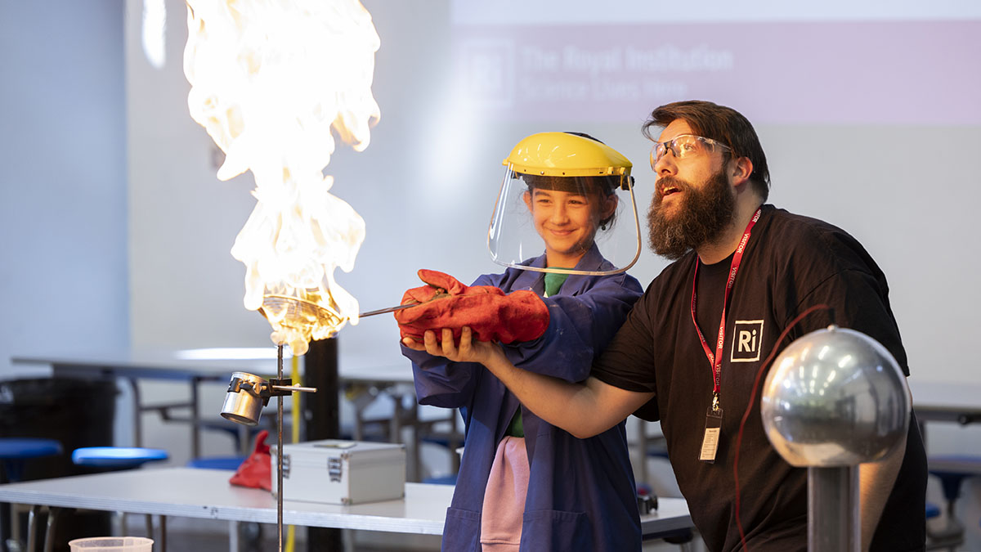
Informing, inspiring and empowering students and those who support them

Slide 21
Informing students
Through its three collections, Big Bang at School aims to inform teachers and students about STEM careers, what they entail and what they can achieve.
50% of students agreed that they learned about the role engineers play in creating greener technologies.
A large majority of students reported knowing the kinds of things that at least one or more of the following professionals do in their jobs: scientists, engineers and people working in technology. Only 5% of young people said they did not know about what people in any of these careers do in their jobs.
The most recent Engineering Brand Monitor (EBM)⁹, conducted in 2021, asked a representative sample of 11-14 year olds the same question. Around 62% agreed that they knew about what scientists people working in technology respectively do, 53% knew about the different things engineers do. This suggests that those attending Big Bang at School events have similar awareness of careers in science and engineering, but not for technology, where EBM respondents are substantially more aware of what jobs in this sector entail.
We cannot compare students’ knowledge before and after the intervention, limiting our ability to assess any change in this regard let alone attribute it as an impact of the programme. This is due to the fact that we do not objectively evaluate students’ knowledge and students were asked to take part in this feedback survey only after having participated in the programme.
However, if students feel more informed, even if only around some specific STEM careers that interest them, this opens up opportunities that would otherwise not be available to them.
Big Bang at School features environmental themes within its collections, and 1 in 2 students said that they learned about the role engineers play in creating greener technologies.
9. EngineeringUK. (2022). EngineeringBrand Monitor. euk2708-parents-report-fv.pdf (engineeringuk.com)

Slide 22
Informing students
It is not enough for students to be inspired or interested to pursue a STEM career. Knowing the next steps to follow such a path is essential, especially as subject choices students make by the end of Year 9 are relevant to future educational and employment opportunities.
Only 37% of students said they knew which subjects they would need to study to pursue a carer in engineering; about one third reported that they did not know.
Similarly, the 2021 Engineering Brand Monitor found that among a representative sample of young people, only 38% knew what subjects they would need to take next.
By Year 9, students will typically have had to think about what subjects to take at GCSE. While some subjects are compulsory at GCSE (maths and sciences), others are optional, including computing and design & technology.
We asked students which subjects they would choose to study, given the option. The table below shows the breakdown by gender. Most students (88%) would choose to study at least one of these subjects.
Overall, design & technology is the most popular option selected by both female and male students. However, since 2012/13, GCSE entries into this subject have fallen by 51%, and still far fewer female students are taking design & technology (29% of entries in 2020/21).¹⁰
The breakdown shows that for the most part female and male students would choose similar subjects. However, some subjects continue to be gendered. Computing is far more popular among male students (47% compared to 27%), while biology is slightly more popular among female students (41% vs 33%).
This pattern is reflected in the wider population of students in England and Wales. In 2020/21, only 21% of all entrants to computing GCSEs were female, while female students made up over 60% of those choosing biology at A-level.⁹
Female students (n=687) | Male students (n=203)
1. Design & Technology (58%) | 1. Design & Technology (51%)
2. Maths (44%) | 2. Computing (47%)
3. Biology (41%) | 3. Maths (43%)
4. Chemistry (34%) | 4. Physics (33%)
5. Computing (27%) | 5. Biology (33%)
6. Physics (26%) | 6. Chemistry (30%)
7. None of these (12%) | 7. None of these (14%)
10. EngineeringUK. (2022). Secondary Education Excel Resource. https://www.engineeringuk.com/research-policy/educational-pathways-into-engineering/secondary-pathways-into-engineering/

Slide 23
Inspiring students
Big Bang at School aims to inspire students towards further STEM study and careers. In the short-term, however, inspiring students may be more likely to affect their immediate interest in STEM activities. We asked students whether the programme made them want to do more STEM related activities.
44% of students
agreed that Big Bang at School had made them want to do more STEM activities.
A logistic regression showed that when holding all other variables constant, STEM engagement, ethnicity and gender remain significant predictors of wanting to do more STEM activities after taking part in Big Bang at School.
Students who reported high STEM engagement prior to Big Bang at School were nearly three times as likely than those reporting low STEM engagement to say that the programme made them want to do more STEM activities (OR = 2.89, 95%CI 1.88-4.45, p<0.05).
Asian students were over twice as likely to want to do more STEM activities after Big Bang at School compared with white students, when other factors are controlled for (OR=2.36, 95%CI 1.59-3.50, p<0.05).
Holding all other factors constant, male students were about three times as likely to agree the programme made them want to do more STEM activities compared to female students, (OR=3.02, 95%CI 1.79-5.12 p<0.05).

Slide 24
Inspiring students
For students who may have been inspired to consider a career in STEM, finding out more about how to pursue this is an important next step. We asked students whether Big Bang at School made them want to find out more about a career in STEM.
Following a logistic regression, having high STEM engagement, ethnicity and gender remain significant predictors of wanting to find out more about STEM careers after participating in Big Bang at School.
Holding all other variables constant, male students were about two times as likely to want to find out more about STEM careers, compared to female students (OR = 2.03, 95%CI 1.23, 3.35, p<.05).
Students categorised as having high STEM engagement were 76% more likely than those with low STEM engagement to want to find out more about STEM careers, when other all other factors are controlled for (OR = 1.76, 95%CI 1.12- 2.78, p=0.01).
Asian students were nearly two and a half times as likely as white students to want to find out more about STEM careers, when other factors are controlled for (OR=2.36, 95%CI 1.59-3.50, p<0.05).
30% of students agreed that Big Bang at School had made them want to find out more about a career in STEM.

Slide 25
Inspiring students
We asked students how interested they are in a career in science, engineering or technology related fields. For the purposes of the regression, we looked at students who were interested in any of those STEM careers in contrast with those who said they were not interested in any.
62% of students said that they were interested in a career in at least one of science, technology and engineering.
A logistic regression identified a number of student characteristics that were found to predict the likelihood that a student would report being interested in engineering, when controlling for other factors.
High STEM engagement was found to increase the odds of being interested in a career in at least one of science, technology and engineering by over 5 times compared with students with low prior STEM engagement (OR = 5.18, 95%CI 3.24-8.28, 9.93, p<.05).
Medium STEM engagement increased the odds of being interested by more than 2 times compared with students with low prior STEM engagement (OR = 2.31, 95%CI 1.53-3.49 p<.05).
Knowing someone in a STEM career increased the odds by around 44% (OR = 1.44, 95%CI 1.00-2.07, p<0.05).
Asian students were about three times as likely as white students to be interested in a career in science, technology or engineering (OR=3.09, 95%CI 1.99-4.13, p<0.05).
Male students were nearly two and a half times as likely as female students (OR = 2.49, 95%CI 1.38-4.48, p<.05).
Students in Year 7 and 8 were around 60% less likely as Year 9 students to be interested in science, technology or engineering career (Year 7:OR=0.62, 95%CI 0.39-0.97, p=0.04; Year 8:OR=0.61, 95%CI 0.38-0.99, 0.36, p<0.05).

Slide 26
Empowering students
For students to consider a career in engineering, they need to believe that they have the ability to succeed in their ambition, and that such a career is open to them. We asked students whether they thought they could become an engineer if they chose to.
39% of students said they thought they could become an engineer if they wanted to.
Following a logistic regression, having high STEM engagement, ethnicity and gender remain significant predictors of the likelihood that a student thinks they could become an engineer if they wanted to, when all other factors are controlled for.
High STEM engagement was found to increase the odds of thinking they could become an engineer by nearly 2 times compared with students with low prior STEM engagement (OR= 1.99, 95% CI 1.30-3.04, p<.05).
Knowing someone in a STEM career increased the odds by around 75% (OR = 1.75, 95%CI 1.24-2.48)
Asian students were nearly twice as likely as white students to think they could become an engineer if they wanted to (OR = 1.91, 95%CI 1.30-2.80, p<.05)
Female students were around half as likely to think they could become an engineer as male students (OR = 0.53, 95%CI 0.32-0.87, p=0.01)

Slide 27
Empowering students
As well as confidence in their abilities, students need to believe that an engineering career would suit them.
22% of students agreed that engineering would be a suitable career for them
74% of students agreed that engineering was open to people from all backgrounds
Despite higher levels of interest in STEM careers, Big Bang at School participants are less likely than 11 to 14 year old EBM participants (54%) to see engineering as a suitable career for them. Of course, it is important to keep in mind that schools involved in the programme meet our EDI criteria, whereas the EBM is based on a nationally representative sample.
However, this finding, alongside the lower interest in engineering among programme participants (30%), suggests more could be done to explicitly demonstrate how engineering is linked to other STEM disciplines and showcase potential careers in the sector.
Several characteristics were found to affect the likelihood that a student would agree that engineering was a suitable career for them when controlling for other factors.
Asian students were about 79% more likely than white students to think that engineering would be a suitable career for them (OR=1.79, 95%CI 1.12-2.87, p<0.05).
Male students were nearly three and a half times as likely to think engineering is a suitable career for them, compared to female students (OR = 3.41, 95%CI 1.99-5.85, p<.05).
High STEM engagement was found to increase the odds of students thinking engineering is a suitable career by two and a half times compared with students with low prior STEM engagement (OR = 2.60, 95%CI 1.43-4.72, p<.05).
Medium STEM engagement increased the odds of students thinking engineering would be a suitable career for them by nearly two and a half times compared with students with low prior STEM engagement (OR = 2.46, 95%CI 1.39-4.35 p<.05).
Knowing someone in a STEM career increased the odds by around 58% (OR = 1.58, 95%CI 1.00-2.48, p<0.05).

Slide 28
Empowering students
By increasing students’ knowledge about STEM, their interest in it and their belief that they can successfully build a career in STEM, Big Bang at School aims to increase the likelihood that young people will pursue a career in science, technology or engineering. While we cannot know if the programme has been successful in achieving that aim, it is useful to understand what young people think about the likelihood of making this career choice.
55% of students said that they were likely to pursue a career in at least one of engineering, science or technology.
How likely are you to pursue a career in STEM?
Following a logistic regression, several student characteristics were found to be associated with an increased chance of a student saying they were likely or very likely to pursue a career in one of these areas.
Students with medium STEM engagement were two times as likely, and students with a high STEM engagement were over three and a half times as likely, to think they were likely to pursue a STEM career compared to students with low STEM engagement (Medium: OR=2.09, 95%CI 1.39-3.16 p<0.05; High: OR= 3.68, 95%CI 2.36-5.75, p<0.05).
Students who know someone working in STEM were 79% more likely to think they were likely to they would pursue a STEM career (OR=1.79, 95%CI 1.26-2.54 p<0.05).
Male students are twice as likely to agree that they are likely to pursue STEM careers as female students (OR=2.04, 95%CI 1.19-3.50 p<.05)
Black students were twice as likely, and Asian students were over three times as likely to say they were likely to pursue STEM than white students (Black students: OR=2.08, 95%CI 1.10-3.89 p<0.05; Asian students: OR=3.34, 95%CI 2.20-5.08 p<0.05;).

Slide 29
Informing teachers
As well as inspiring and informing students, Big Bang at School aims to support and inform teachers who provide essential guidance to students around future study and career options. Teachers can be instrumental in encouraging students to follow STEM subjects and career paths but can also be a barrier if they do not know about the diverse range of options available in STEM careers.
96%
Agree or strongly agree that they knew about the kind of things scientists can do in their jobs.
Teachers had very good knowledge about engineering, science and technology careers.¹¹ They are also knowledgeable in the next steps that students would need to take to becoming a scientist or engineer:
98% agreed (40%) or strongly agreed (57%) that they knew what subjects or qualifications their students would need to take next to become a scientist in the future.
96% agreed (36%) or strongly agreed (60%) that they knew what subjects or qualifications their students would need to take next to become an engineer in the future.
11. The sample size in each group was not big enough to explore any differences by whether respondents teach a STEM subject or not. However the higher knowledge around science career could be due to the fact that most respondents reported teaching a science subject.

Slide 30
The impact of Big Bang at School on teachers
Beyond teachers’ knowledge of STEM careers and next steps to pursue those pathways, it is important that they feel confident in providing advice to students.
61% of teachers said they were more confident giving engineering careers advice after taking part in Big Bang at School
In general, responding teachers felt confident about advising students around STEM careers, though confidence was slightly lower around technology than engineering or science.
96% of teachers felt fairly (26%) or very (70%) confident giving advice about science careers; 91% felt fairly (49%) or very (43%) confident giving advice about engineering careers; 81% felt fairly (45%) or very (36%) confident giving advice about technology careers.
Over 95% of respondents said they had recommended that a student consider a career in engineering in the last 2-3 years (2% reported they didn’t know and 2% said they had not).
Over 8 in 10 respondents (81%) said they were more likely to recommend engineering as a career after taking part in Big Bang at School.
A large majority of respondents agreed that their school supported pupils to develop the skills needed to pursue engineering: 53% strongly agreed, 43% agreed, 2% neutral and 2% disagreed; no respondent strongly disagreed.

Slide 31

Learning for improvement

Slide 32
Learning for improvement: student feedback
Students who did not enjoy taking part in the Big Bang at School were asked for suggestions on ways we could make the programme more enjoyable. We received nearly 40 free text responses categorised below to show which aspects of the programme were commonly mentioned.
Over one third of responses mentioned they did not know about ways to make Big Bang at School more enjoyable. However, the remaining responses included the following suggestions:
Just ‘add more’
Eleven responses mentioned more activities, specifically ones that are fun and practical, would make the programme more enjoyable. Some reported examples to achieve this through adding more experiments or offering prizes.
Consider ways to be more inclusive
Ten responses included references to the need for the event to be more inclusive and age appropriate. For example, suggesting simplifying language by ‘using words that we know’.
Number and selection of students
Five also mentioned it’s worth considering the number of students who take part, saying the event they took part in was too crowded and noisy. One student suggested only inviting students who are interested to take part in the activities.
“You could make it more enjoyable by making some of the experiments more understandable. I went to some stall and their experiments were very complex so I did not understand what their experiments actually were.”
“Make it better for people with social anxiety.”
“Make the building part more fun: add a timer or whoever finishes first gets a prize maybe.”
“By adding more activities to careers to make it more enjoyable.”
“[Make it] more fun and not really learning but learning in a way that you make things.”
“Only let people part take who want to instead of forcing uninterested students to learn about something they aren't interested in.”

Slide 33
Learning for improvement: teacher feedback
Teachers were asked for suggestions about how to improve engagement with students from groups under-represented in engineering. One third of responses mentioned the programme was already effective at engaging these groups. The remaining responses referred to a variety of suggestions grouped by: diverse speakers and content, tailoring and targeting activities and practical considerations for delivery.
Diverse speakers and content
Teachers suggested having diverse speakers or more explicit role models. One response mentioned it might be worth having engineering related speakers, while another mentioned showcasing a diverse range of STEM areas would be beneficial (rather than specialisms students have already heard about before). Beyond the diversity of the speakers and content, one response mentioned having more hands on activities may be beneficial at engaging under-represented groups in engineering. Another suggestion was for activities to be more explicitly linked to careers, demonstrating to students how they are connected to roles or jobs in STEM.
Tailoring and targeting activities
This includes considering the abilities of participating students and planning in more detail how to engage SEND students in STEM learning. Another suggestion was to target student participation, ensuring the same number of female and male students are encouraged to participate in activities.
Practical considerations for delivery
This includes planning time allocated for sessions throughout the year, financial support for teacher cover and more resources. Although the response doesn’t specify the themes of resources, it could be general resources on how to support and engage students in these groups.
“We ran the event across all the classes - so all pupils were able to engage equally.”
“I noticed that only one of the presenters was a woman and none were from a minority ethnic group. My suggestion would be to have presenter from a more diverse background. This would inspire girls and children from ethnic minority groups.”
“Ensure the careers fair part has more presenters, and short activities to try or picture and props to show what the jobs are like.”
“Planning more days over the year and plan one day where we can bring ks4 and ks5.”

Slide 34
In depth: Ways to improve participation
Through interviews with teachers, participants shared their suggestions on ways to improve participation and student engagement in schools.
General suggestions
Carry out school consultations in particular with special schools to tailor resources to student needs and ensure activities are accessible.
Improve communication, in particular related to bursaries, deadlines for online applications (for bursaries and Big Bang Competition), branding schools can use for the events and process for fulfilling the school agreement requirements.
Share examples of delivery. There is an interest in knowing about what other schools and teachers are doing for their Big Bang at School and how the bursary funds are used.
Create a network of teachers to share experiences or ideas for Big Bang at School activities. This was highlighted as particularly helpful for new schools joining the programme.
“We don't often get given money in schools to spend on what you want and linked to STEM, for example, and so some kind of more detailed ideas of what you could spend [the bursary] on. I just know that if you're new to this role or if you’re planning the event for the first time, what to spend the money on that could be in a lasting, meaningful way, sometimes is a quite difficult thing to think.”
“I thought your website and the resources were all really accessible having the templates and everything there just to reduce the time and workload of organizing that. I mean, maybe some sort of network of schools [as an improvement]. Say for instance, somebody else in my area, if they'd done that [a Big Bang at School] before, it would have been quite helpful to maybe contact them and say so…How did you do it? How did you do this? Uhm, how did it go? What worked well? What didn't?...Can you recommend any local businesses? Or that kind of thing.”

Slide 35
Learning for improvement: teacher feedback
We asked teachers what additional support they would find helpful when speaking to students about engineering careers. Nineteen respondents gave suggestions about what would be useful for them.
Information about roles and pathways towards engineering
Seven teachers suggested that up to date information on the range of roles in STEM would be helpful. Five of these also suggested it would be beneficial to have information on different pathways into engineering, other than academic ones.
Some teachers specifically mentioned the usefulness of having example job summaries or profiles with roles and responsibilities outlined. Others mentioned the information should be clear, concise and easy to understand for students (age appropriate).
STEM professional engagement
Six of the 19 comments suggested that more interaction with engineers, particularly in-person, would be helpful. Another suggestion included increasing the number of volunteers who can support schools in the event by facilitating sessions.
Additional resources
Three teachers suggested having more resources in general about engineering careers. One suggested these should be easy to share with students (e.g. PowerPoints or weblinks). Another suggested resources to run short activities blended with the curriculum.
“Offering [students] insights to various jobs in engineering via video links or in person talks with engineers or interactive games.”
“More engineers to come in and speak to us and our students.”
“Visits from Engineers, Scientists and IT professionals.”
“Careers profiles with key points about qualifications needed, job description, salary, route into the careers other than attending university.”
“Posters with the careers are a really nice way to have information up around the school.”

Slide 36
In depth: Wider impact of Big Bang at School
Another aim of the teacher interviews was to explore any wider impact that teachers feel Big Bang at School has had in their school.
Teachers shared their views on the wider impact of running a Big Bang at school, seeing running the event as a:
Possibility to build on the success and learning for future years to establish a legacy within the school. In one case the success of the first year delivery of Big Bang at School lead to increased student demand to join the school’s STEM club and additional school funding allocated to STEM
Opportunity for students to engage with potential future employers and build confidence when interacting with other adults
Opportunity for the school to build relationships with local employers for future STEM activities
Future plans
There is an interest in using Big Bang at School to foster a STEM culture in schools. For example:
By raising awareness of what STEM is and what careers in these sectors could include
Leveraging older students to run workshops /share learning with their younger peers
Fostering school ownership of the event is also seen as an important element:
Some future plans involve possibly spending money towards equipment rather than external workshops
Some shared they were looking to take a more active role in developing or adapting resources that are tailored for students of different abilities
“I already yesterday spoke with the head teacher about increasing the funds for the STEM club like that because even the school themselves, the SLT, they saw the impact of it [Big Bang at School] and how the kids engaged. They will help us also with a little bit of funding for the future […]. I think that it's a long term impact because they are taking me more seriously when I speak…it's not anymore like just a science club to have fun. They see what can be done with it. And I think the people in SLT who are not from a science background could see that. Because in our SLT there is only one science teacher and one math teacher. The rest are from English, history or geography then they couldn't see it, but when they came and they saw what we can do with it, I think they also want to be part of it.”

Slide 37
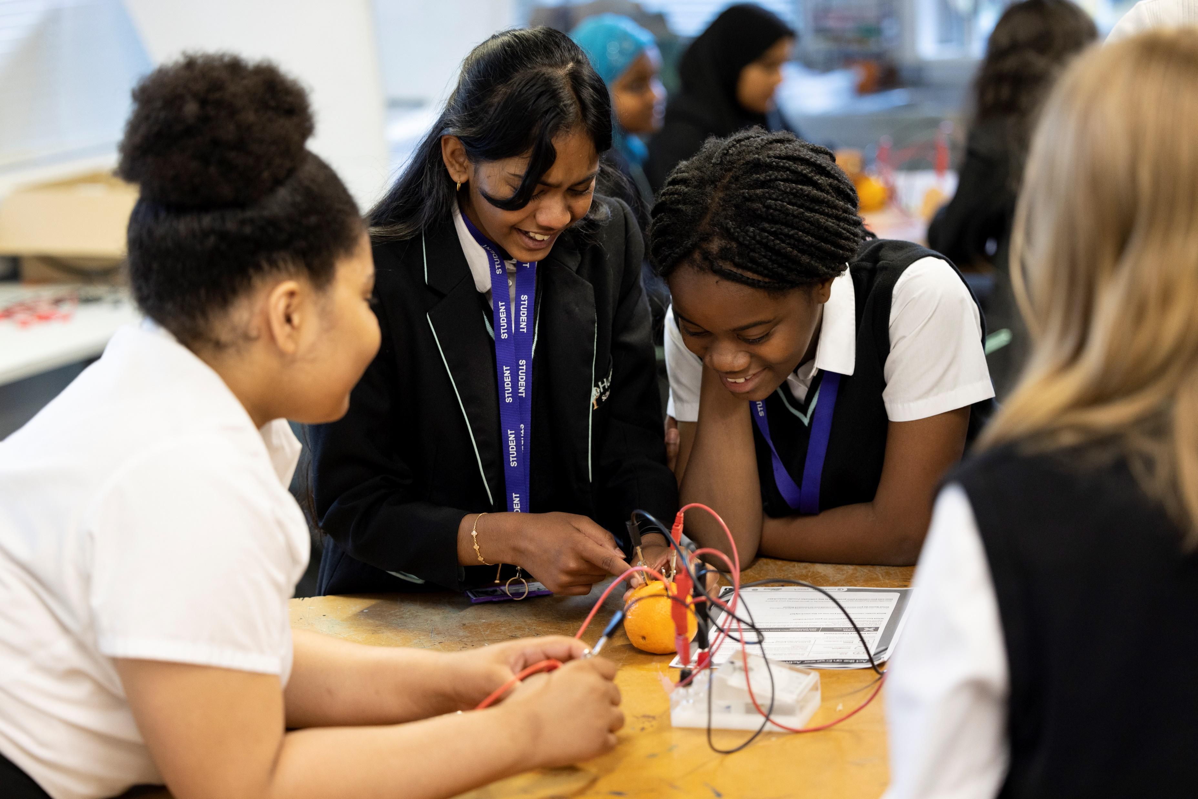
Conclusions and recommendations

Slide 38
Conclusions
The Big Bang at School programme enables schools to have an exciting, inspirational, and impactful STEM event in their own school environment, demonstrating the breadth of STEM careers and getting students hands on with STEM activities and workshops. Our evaluation findings suggest the most immediate outcomes of the programme were for the most part achieved. Both teachers and students shared their positive view of Big Bang at School, engaging students with hands on STEM activities. However, findings also suggest more could be done to support teachers on engaging with engineering professionals and inspire students about STEM.
Experiences of Big Bang at School
Students reported they enjoyed taking part in Big Bang at School (74%) and teachers rated the programme very highly (94%), agreeing it is engaging for their students (88%).
Teacher rating is down slightly compared to last year, and some of the feedback in this report may help to explain this, in particular with regard to the timings and communication around the bursary. Despite these, overall enjoyment is high.
Big Bang at School is particularly enjoyable for students who already know someone working in STEM, but findings also suggest it may be equally enjoyable for students with different levels of prior STEM engagement. This suggests the programme may be as effective at sparking as well as fostering interest in STEM.
Inspiring students about STEM
44% of students felt that the
programme made them want to do
more STEM activities and 30% agreed they wanted find out more
about STEM careers afterwards. This was
particularly true for students who are
already highly engaged in STEM
activities, male students and Asian students.
Engaging students in STEM activities
Overall, students particularly enjoyed the hands on aspect of activities and the variety of student project work. Having fun, while also learning about STEM careers were valued as well.
Teachers also tended to agree that Big Bang at School was engaging to students across a range of abilities in STEM. However, considering their feedback, the programme may not be as successful at engaging all students, in particular students from minority ethnic groups. Given that Asian students were more likely to enjoy the programme (compared to white students), we must also refrain from generalising findings for students from various ethnic backgrounds that often tend to be grouped together.
Demonstrating the breadth of STEM careers
Although fewer teachers directly mentioned the information on STEM careers, it is still considered a positive element by some. It could be the case that more schools may need support on linking programme activities with STEM careers, or facilitating student engagements with STEM professionals. Only 33% of teachers said their students met an engineering professional during the programme.

Slide 39
Conclusions
Programme reach and participation
Big Bang at School is delivered mostly to all students in one or more year groups (55%), or to the whole school (23%). Our findings suggest that some schools also invite local primary or secondary schools to take part in some, if not all, day activities. Teachers reported that, on average, 260 students per school participated in the programme.
Given the flexibility that schools have in delivering an event that is tailored to their context, it is likely that the programme is delivered in quite different ways across participating schools.
Teacher support
Teachers value how engaging the activities are for their students, mentioning the importance of the variety in activities and practical elements of Big Bang at School. Teachers also highlighted as positive aspects the support received during the overall organisation and planning of their event as well as resources provided.
Wider impact
Teachers mentioned various ways in which the programme has impacted STEM in their schools. There is also some evidence that teachers are building on the momentum of their experience as a foundation for future STEM engagement plans. The visibility of delivering such an event in schools appears to have the potential of raising the profile of STEM in schools.
Limitations
As shown in this report, the students who participated in the survey, in large part, skewed towards girls. This is due to three all girls schools making up most of the responses (640 students).
Further, the data does not allow us to compare student views before and after taking part in the event so we cannot conclude that the findings presented here are the result of their experience of the programme. However, a pre and post evaluation approach was piloted with a small number of schools and those findings are presented in a separate report.
Similarly, we see that teachers are slightly more knowledgeable about science careers compared to engineering ones. This could be due to participation in the programme, but also due to the subjects they teach.

Slide 40
Recommendations
Based on the evaluation findings and feedback from teachers and students, the following are proposed recommendations for improvements.
Emphasise the hands on element
Practical activities were considered the most enjoyable and engaging aspect of the programme by both teachers and students. It could be a way to include students of varying interest or ability in STEM.
Provide practical resources on event planning and showcase examples Student feedback highlighted some elements that would be worth highlighting in resources for teachers delivering the event (e.g. using age appropriate language, considering the number of students participating and spaces available). Teachers, particularly those new to the programme, also highlighted event planning as a challenge.
We know that schools tailor and deliver the programme in different ways to their own contexts. Sharing with schools resources on inclusive delivery and examples of participation could help others in making decisions around the time to allocate for delivery or the ways to spend additional funding.
Clearly communicate programme process and requirements
Even though teachers highlighted as positive aspects the overall organisation and support from delivery partners or the Big Bang at School team, some teachers mentioned clear information about timelines and additional funding would be beneficial to have in advance.
Consult with SEND schools
There is a wide range of different abilities among students with special needs and related considerations for tailoring programme delivery. It is essential that SEND schools are consulted for an effective and engaging event.
Showcase the range of STEM areas
Teachers may need additional support in showcasing the diversity and variety of STEM areas and careers. Some highlighted they would find it useful to have additional information on roles and pathways into engineering.
Clarify the link between activities and STEM careers
This would particularly benefit students who don’t already make a link between participating in the programme and future STEM career aspirations. It could also help showcase the range of STEM careers.
Support teachers in engaging with STEM professionals
This was highlighted as a challenge by some schools. EngineeringUK is in the unique position with access to a wide network of engineering professionals and should leverage this to support schools.
Create a network of teachers
Teachers, especially new ones to Big Bang at School, may find this as a particularly helpful way to learn about different experiences or ways of delivering the programme directly from other teachers.

